Slide 1
Attributes of professionalism related to ethics

Slide 2
Definition of medical professionalism
Medical professionalism comprises a set of values , behaviours and relationships that underpins the trust the public has in doctor
- royal collage of physicians,London 2005

Slide 3
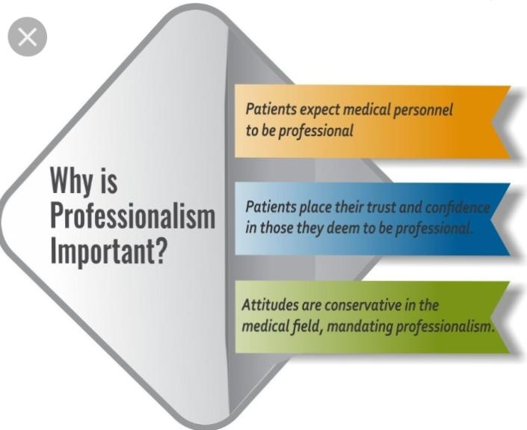

Slide 4
Attributes of professionalism
Professional Responsibility
Competence and Self-Improvement
Respect for Others and Professional Relationships
Social Responsibility
Honesty
Health
Function under stress
Appearance
Tolerance
Dependability
Research Ethics

Slide 5
Professional Responsibility
The student is internally motivated to place the patient’s concerns before his or her own.
He or she always helps to create a positive learning environment
Punctual
Attends all activities at which he or she is expected.
Reliable in completing tasks related to the care of patients

Slide 6
Competence and Self-Improvement
Students to be committed to learning and mastery of medical knowledge, skills, attitudes and beliefs.
The motivation for this learning is always the optimal future care of patients.
The student knows the limits of his or her abilities, and always tries to improve.

Slide 7
Respect for Others and Professional Relationships
Medical students always respect their patients as individuals.
There is respect for the patient’s dignity, privacy, cultural values and confidentiality.
Students demonstrate sensitivity, respect, compassion, emotional support and empathy at all times—to patients, as well as their families, other health care team members and their peers.

Slide 8
Social Responsibility
Societies place physicians in positions of power and authority with control over patients’ and their families’ well-being, as well as over their lives
must always conduct ourselves in a manner worthy of that trust
must go beyond medical treatment for individuals, advocating individuls and families for improvement in the broader conditions that affect health.

Slide 9
Function under stress
Doctor or student should have skill in critical thinking, problem solving and guiding other colleagues
we should maintain professional composure and exhibits good personal and clinical judgment in stressful situations.

Slide 10
Honesty
Medical students are committed to honesty at all times, including their interactions with:
Patients
Patient’s families
Other professional colleagues
Peers
We need transparent ,responsive ,clear communication

Slide 11
Appearance
Displays appropriate professional appearance
Appropriately groomed
Students must comply with the university dress code

Slide 12
Tolerance
The student is expected to demonstrate ability to accept people and situations.

Slide 13
Altruism
Altruism is the devotion to others through complete forgetfulness of ones own concerns.
It is very important that doctors help patients without expecting any benefits or self gain from doing so.
Our own needs should be suppressed when it comes to the welfare of a patients health.
Societal pressures and administrative needs must not compromise this principle.

Slide 14
Research Ethics
Plagiarism is the presentation of someone else’s work as your own.
If you use another author’s words you must attribute the work to its original source (its author, composer, etc.).
If you borrow an idea from, or directly quote from, another person’s work, you must cite the source of that idea or quote.

Slide 15
Social Media etiquette

Slide 16
Thank you!!

