Slide 1
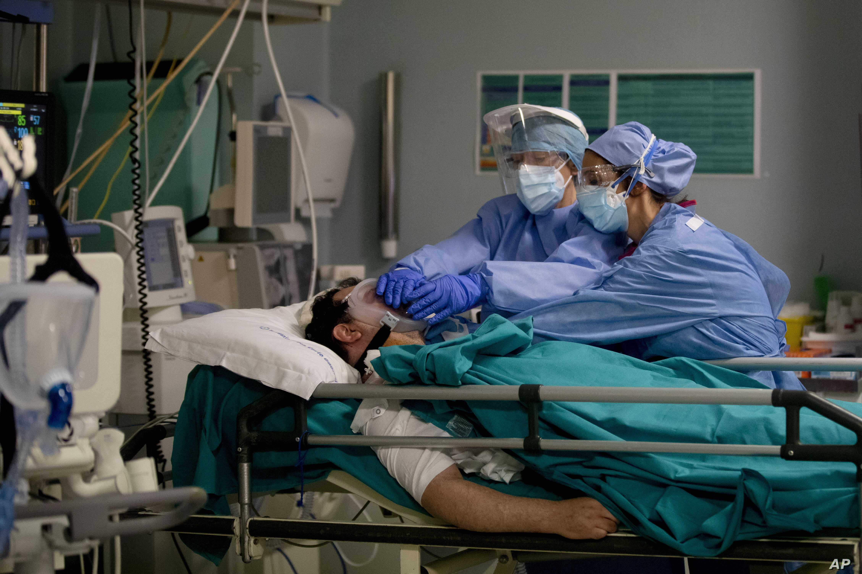
Cause of Death
in the times of COVID-19
Department of Forensic Medicine
University of Kelaniya
2021

Slide 2
Hello!
This is an interactive learning activity to improve your knowledge on the figuring out the cause of death and filling the Death Declaration Form (B33).
This is an essential part of the duties expected from you as a future House officer.
We are covering COVID-19 and different roles it plays in determining the cause of death.
You can use arrow keys to navigate the presentation or click on the hyperlinked texts or images to go to relevant slides.

Slide 3
Main menu
Lets review your knowledge on cause of death
Lets do some cases
Learning materials
Creators

Slide 4
Lets review your knowledge on cause of death
Think about the answers to the following questions
What is the declaration of death?
When can a doctor declare the cause of death?
What is Death declaration form?
What is Certificate of cause of death?
What are the criteria to be satisfied when you issue a certificate of medical cause of death?
Click here for the answer
Click here for the answer
Click here for the answer
Click here for the answer
Click here for the answer
Main Menu

Slide 5
What is the declaration of death?
An announcement, often one that is written and official of a person’s death provided by a responsible/ reliable person like a Medical person/ Civil officer, which is needed to issue the death certificate by the Register General.
Back
Main Menu

Slide 6
When can a doctor declare the cause of death?
Death declaration depends on where the death occours as well as circumstance.
Death
Health Care Institution
State Health
Private health
Community
Home
Public
Death Declaration Form B 33
Back
Certificate of cause of death B 12
Main Menu

Slide 7
What is Death declaration form?
It Is the Registration B33 form given in these pictures.
It is the form filled when a death happens at a heath care institute.
This is a declaration to the Registrar of deaths sating the cause of death, where the doctor is functioning in the capacity of declarant.
However if an inquest is required this form must not be filled.
Click here to view magnified picture of the form
Click here to review when an inquest must be ordered
Back
Main Menu

Slide 8
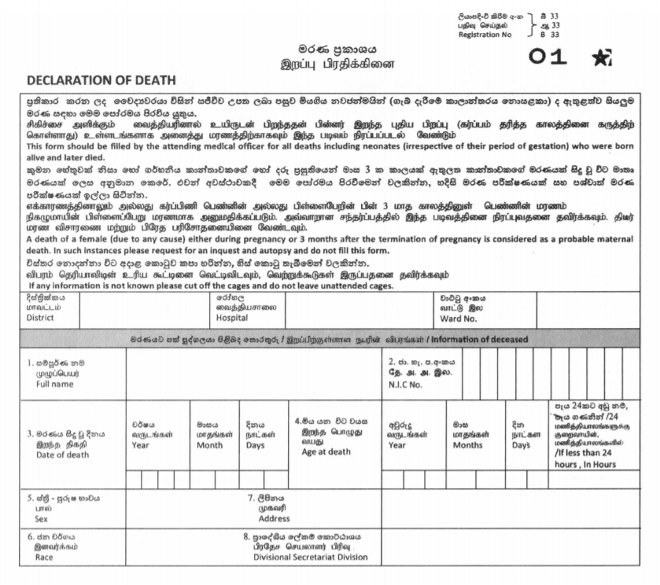
Next
Back
Main Menu

Slide 9
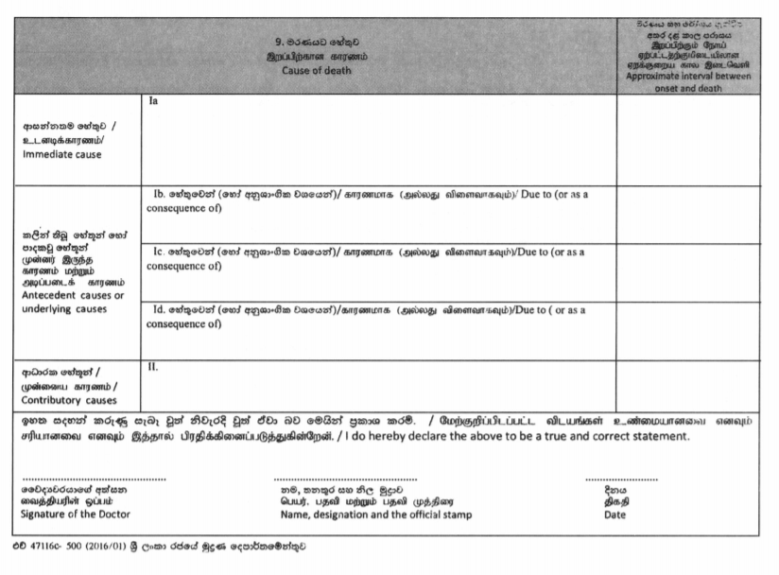
Back
Main Menu

Slide 10
When do you need to do an inquest?
Select all situations where we need order an inquest.
Suicide
Killed by an animal, machine or accident
Death at the hospital where treating physician is certain about the cause of death
Sudden death where cause of death is unknown
While in custody (police, mental or leprosy hospital, prison)
Death by violence
Death after long period of illness while staying at home
Suspicious circumstances surrounding death
Death due to rash and negligent act by another person
Killed by another person
Back
Main Menu

Slide 11
What is Certificate of cause of death?
It is the Registration B12 form.
This is what is recommended to be used by the medical officers certifying death in a non institute setting. Ex: General practitioner certifying cause of death of a regularly treated patient with a known illness.
But in practice this is not done. Usually cause of death is written on letterhead of the doctor.
Click here to view an enlarged picture of this form.
Back
Main Menu

Slide 12
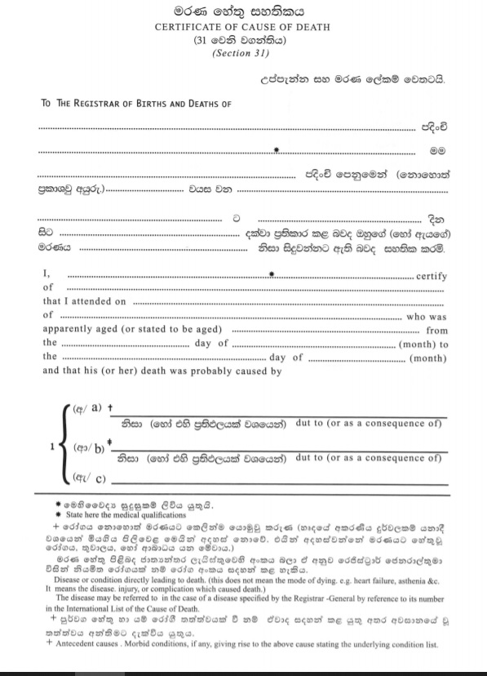
Back
Main Menu

Slide 13
What are the criteria to be satisfied when you issue a certificate of medical cause of death?
The cause of death is known
The cause of death is natural
The doctor being attending physician of the last illness of the deceased
The doctor has treated the deceased recently
The doctor has viewed the body
Back
Main Menu

Slide 14
Now lets go through some cases!
Following slides will give you both COVID-19 related and unrelated deaths.
Attempt to fill the answers by yourself, before revealing the correct answer
Next
Main Menu

Slide 15
1. A 58-year-old male with a past history of arterio-venous malformation since he was of 45 years of age, was brought to the hospital due to a sudden onset of altered level of consciousness and difficulty in breathing for 20 minutes and the CT scan showed intracerebral haemorrhage. He expired prior to active management.
Write the cause of death for the above scenario.
Next
Back
Main Menu

Slide 16

1(a) Intracerebral haemorrhage 20 minutes
1(b) Arterio-venous malformation 13 years
Answers
Next
Back

Slide 17
2. 46-year-old male who was a diagnosed with dyslipidemia and hypertension for 2 years, was admitted to NCTH Ragama medical casualty with tightening type, progressive chest pain for 2 hours. His ECG showed extensive ST elevation and a myocardial infarction was diagnosed, and thrombolysis started. His vital parameters were unstable, and he was on two inotropes. Despite treatment he died on day 2.
When questioning the family, it was revealed that he had not stopped smoking despite medical advice.
If you are the House officer in medical ward, write the cause of death for above case scenario.
Next
Back
Main Menu

Slide 18
1a) Acute myocardial Infarction 2days
2. Hypertension, dyslipidemia 2 years
Smoking
Answers
Next
Back

Slide 19
3. A 52-year-old male who was a known patient with bronchial carcinoma for 2 years who had defaulted treatment, presented to medical ward complaining worsening loss of appetite and abdominal pain for one month. He underwent several investigations (USS & CT) and found to have liver metastasis. A liver biopsy was done, and patient developed bleeding into the peritoneum. A laparotomy was conducted 2 days later, and extensive metastasis was found. The biopsy site bleeding was attended. He died in the ICU the following day. According to the wife and the son, he was a heavy alcoholic and a smoker for the past 34 years.
Write the cause of death as the Medical Officer in the ICU where the above patient had died.
Next
Back
Main Menu

Slide 20
1(a) Disseminated tumor metastasis 1month
1(b) Bronchial Carcinoma 2 years
2. Smoking and alcohol consumption 34 years.
Answers
Next
Back

Slide 21
4. A 77-year-old male, who was a known patient with chronic kidney disease for past 4 years, was admitted to a base hospital with a complaint of reduced urine output and shortness of breath for 3 days duration. He was treated there for 2 days and transferred to NCTH Ragama for nephrology opinion. Following day he was found unconscious with a GCS of 3. Despite resuscitation, he died. His blood gas analysis showed acidosis. He was suffering from hypertension for a 22 years.
There was a wound in right leg and evidence of cellulites was found.
If you are the House officer in medical ward, write the cause of death for above case scenario.
Next
Back
Main Menu

Slide 22
1a) Acute Kidney Injury 6 Days
1b) Sepsis 6 days
1c) Right leg cellulitis
2) Chronic Kidney Disease for 4 years and
Hypertension 22 years
Answers
Next
Back

Slide 23
5. A 64-year-old man complained of abdominal pain and fever on 09.04.2019 was admitted to NCTH Ragama on 10.04.2019 with a severe pain in right iliac fossa. Investigations revealed, low WBC counts with neutrophilia, electrolyte imbalance, acidosis, increased serum creatinine and blood urea levels, increased liver enzyme levels. His condition deteriorated further and was taken to the ICU. He died on the same day. He was a diagnosed patient with alcoholic cirrhosis for 3 years and diabetes mellitus for 1 year.
Write the cause of death for the above scenario.
Next
Back
Main Menu

Slide 24
1(a) Hepato-Renal Syndrome 1 day
1(b) Septicemia 2 days
1(c)Spontaneous bacterial peritonitis 2 days
1(d) Cirrhosis of the liver ( Alcoholic cirrhosis) 3 years
2. Diabetes Mellitus 1 year
Answers
Next
Back

Slide 25
6. A 7-day-old neonate of a heroin addicted mother for 3 years had a normal vaginal delivery at term, and had aspirated meconium at birth 7 days ago. Baby was ventilated from day 1 onwards, but the condition deteriorated. Patient developed bronchopneumonia 6 days ago and was treated for it. The baby expired on the 7th day of life.
The baby was a mature baby without any obvious congenital anomalies.
Write the cause of death for the above scenario.
Next
Back
Main Menu

Slide 26
1(a) Bronchopneumonia 6 days
1(b) Meconium Aspiration 7 days
2. Maternal heroine addiction 3 years
Answers
Next
Back

Slide 27
7. 28-year-old male who owned a tractor was engaged in moving building materials. On 27.2.2020 around 3.35p.m., while he was crossing the railway tract at Weligampitiya junction the tractor collided with an engine of a train that was going towards Colombo. According to the gate keeper, the rail gate was opened when the tractor was crossing, and it collided with the engine of the maintenance train, and the driver was thrown on to the railway tract. He died on the spot. During the autopsy, he was found have suffered multiple injuries to the head , chest and abdomen and had major bleeds.
Write cause of death for above scenario.
Next
Back
Main Menu

Slide 28
1a) Multiple injuries to head, chest and abdomen one day
1b) Blunt impact trauma one day
1c) Collision with a train
Answers
Next
Back

Slide 29
8. 22-year-old male who was working in a garment factory, was having an affair with a girl for past 6 months. Recently, he was having some disputes with the girl he was dating. On the morning of 24.01.2021, his mother found him hanging in his room by a cloth from the rafter. The room was locked form inside. Mother found a suicidal note in his diary and in the computer. He was a healthy male prior to his death. Autopsy was conducted and revealed no injuries in body other than a ligature mark blackish purple in color, above the Adam’s apple that encircles the anterior neck except the back.
Write cause of death for above scenario.
Next
Back
Main Menu

Slide 30
1(a) Ligature suspension by neck one day
Answers
Next
Back

Slide 31
9. 40-year-old, previously healthy male was tested positive for COVID-19 two weeks back at his work place. He was quarantined in a quarantine center and transferred to NCTH as he has developed symptoms of pneumonia 1 week after. He has suffered from respiratory distress for the last 3 days before his death at NCTH.
Write the cause of death according to WHO guidelines for the above scenario.
Next
Back
Main Menu

Slide 32
1a . Acute Respiratory Distress Syndrome 3 days
1b. Pneumonia 7 days
1c. COVID- 19 test positive 14 days
Answers
Next
Back

Slide 33
10. A 70-year-old female, who was a primary contact of a patient tested positive for COVID-19, presented with influenza-like illness of 4 days duration to the NCTH Ragama. She developed respiratory distress and died a day later at your ward. The test result of COVID-19 is not available. She has been suffering from type 2 diabetes mellitus and hypertension for the past 10 years.
Write the cause of death for the above scenario as the house officer of the ward.
Next
Back
Main Menu

Slide 34
1a. Acute Respiratory Distress syndrome 1 day
1b. Influenza like illness 5 days
1c. Suspected COVID-19 5 days
2. Type 2 diabetes mellitus and hypertension 10 years
Answers
Next
Back

Slide 35
11. 28-year-old primi gravida with a 32 weeks of period of gestation, has been found to be positive for COVID – 19, four days ago during her routine clinic visit. There she had been diagnosed with pregnancy induced hypertension, complicated with pre eclampsia. 3 days after her clinic visit , she had a eclamptic fit at home and died on the way to the hospital. She also suffered from Gestational Diabetes Mellitus for the past 1 month.
Write cause of death for the above motioned scenario as the attending Medical Officer.
Next
Back
Main Menu

Slide 36
1a. Eclampsia one day
1b. Pregnancy Induced hypertension 4 days
2 Gestational Diabetes mellitus 1 month
COVID 19 test positive 4 days
Answers
Next
Back

Slide 37
12. A 53-year-old man, was admitted to NCTH Ragama, following a road traffic accident. On admission, he had lost his consciousness and was there for 2 days duration and died on the 2nd day. CT scan showed a left sided cerebral haemorrhage. He was a diagnosed patient with type 2 Diabetes mellitus for last 5 years. He had tested for COVID-19, 3 days ago due to close contact of a positive patient and his report came as positive one day after his accident.
Write the cause of death of this patient.
Next
Back
Main Menu

Slide 38
1a. Cerebral Hemorrhage 2 days
1b. Motor vehicle accident 2 days
2.COVID 19 ( Test Positive – Incidental finding) 1 day
Answers
Next
Back

Slide 39
Learning Materials
https://www.srilankamedicalcouncil.org/download/download/22/2894475624a6e3c757587eac3fe24c9c.pdf
https://www.epid.gov.lk/web/images/pdf/Circulars/Corona_virus/certification_of_death_and_reporting.pdf

Slide 40

Creators
Dr. P. Wijayarathne
Dr. D.P.S. Govinnage
Dr. D. N. Alwis
Supervisor
Prof. P.A.S. Edirisinghe

Slide 41

Thank you!

